Slide 1









Air Pollution Detection Using InceptionV3 (Transfer Learning)
Leveraging Machine Learning for Environmental Monitoring
Presented by : MANVI BAMAL & SHAMBHAVI KUMARI

Slide 2

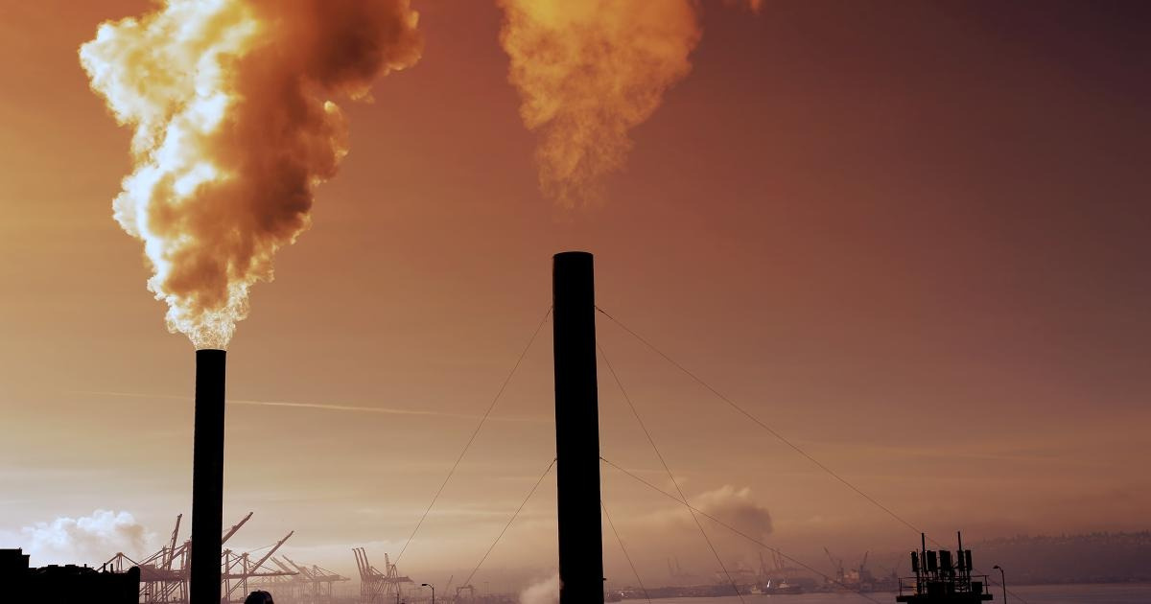
Why Air Pollution Detection Matters
Air pollution is a global concern, causing health risks and environmental degradation
Traditional detection methods are costly and require extensive infrastructure.
Develop a cost-effective, accurate, and scalable solution to detect pollution levels using images.

Slide 3
Goals of the Project
Utilize transfer learning with the InceptionV3 model to classify air pollution levels.
Train a robust model using labeled image datasets.
Deploy the model for real-time predictions with high accuracy.

Slide 4
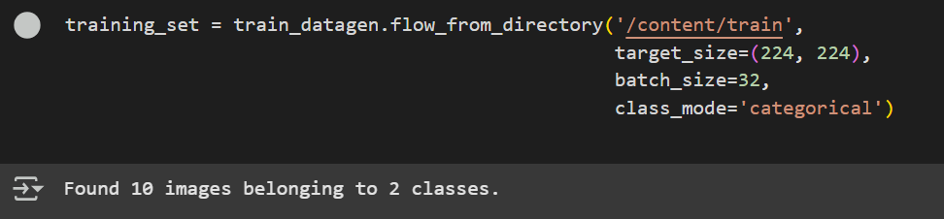
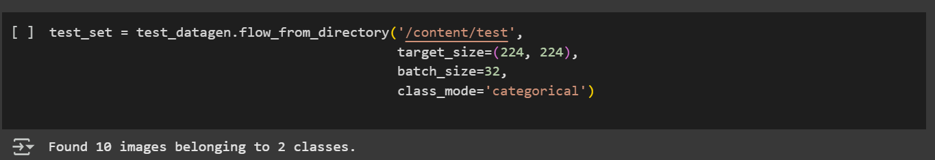

Dataset Description
Dataset Size:
Structure: Images labeled into categories such as "Low Pollution," "Moderate Pollution," and "High Pollution."
Source: Dummy Air Pollution Dataset

Slide 5
Workflow
Data Preprocessing:
Applied normalization and augmentation techniques (e.g., shear, zoom, flip).
Model Architecture:
Used InceptionV3 as the base model with pre-trained ImageNet weights.
Added custom dense layers for classification.
Output layer:
Softmax activation for multi-class classification.
Training:
Compiled the model with Adam optimizer.
Loss function:
Categorical Crossentropy.
Metrics:
Accuracy
Evaluation:
Validated using unseen test data.
Measured metrics:
Accuracy, precision, recall.

Slide 6

InceptionV3-
based Model
Base Model: InceptionV3 (pre-trained on ImageNet).
Custom Layers:
Flatten layer to convert feature maps into a vector.
Dense layers for feature learning.
Output layer with softmax activation.
Freezing Weights: Prevented updates to pre-trained layers during initial training.

Slide 7
Model Performance
Accuracy: 0.4
Loss: 0.0006676053162664175
Metrics (Precision, recall, and F1-score): 0.40, 0.40, 0.40

Slide 8

Key Challenges
Limited dataset size.
Overfitting during training.
Hyperparameter tuning for better performance.
Computational resource constraints

Slide 9

Prediction Samples
Test Image: Display an image from the test dataset.
Predicted Class: [Predicted pollution level.]
Include a visualization of actual vs. predicted results (e.g., confusion matrix).

Slide 10

Enhancements and Applications
Real-time Implementation: Deploy the model for live air pollution detection via drone-captured images.
Dataset Expansion: Collect and use larger datasets for improved performance.
IoT Integration: Combine with sensors for a hybrid detection system.
Broader Use Cases: Extend the model to other environmental monitoring tasks (e.g., water pollution).

Slide 11

Summary
Demonstrated the potential of transfer learning for detecting air pollution.
Achieved [state your key achievement, e.g., "90% accuracy on the test dataset"].
Proposed further enhancements for scalability and real-world deployment.

Slide 12
Questions & Feedback
Thank you very much!

